Slide 1
Self Service Library

Slide 2
What does it do
Authentication
Authenticate using CVUT identity provider. Do not store passwords or user related data.
Context
Fetching user context from CVUT Usermap API. Recognize the users and their student or technical roles.
Books
View books, borrow and return the books.

Slide 3
Process is simple
Borrow a book
Make a reservation online
Bring your student ID card to the library
Scan your card and the book at the kiosk terminal.
Return a book
Bring the book and your student ID card
Scan both at the kiosk terminal
and that’s it!

Slide 4
Why is it unique?
Because there is no librarian in the process, at least no the human one.

Slide 5
Benefits
Easy setup
Plug n play with docker compose config
The UI is a web app so it can run on anything capable of running modern browsers
Integration
Can be integrated with existing library CMS thanks to REST API
Self-service
Human personal is not needed for borrowing and returning of books

Slide 6
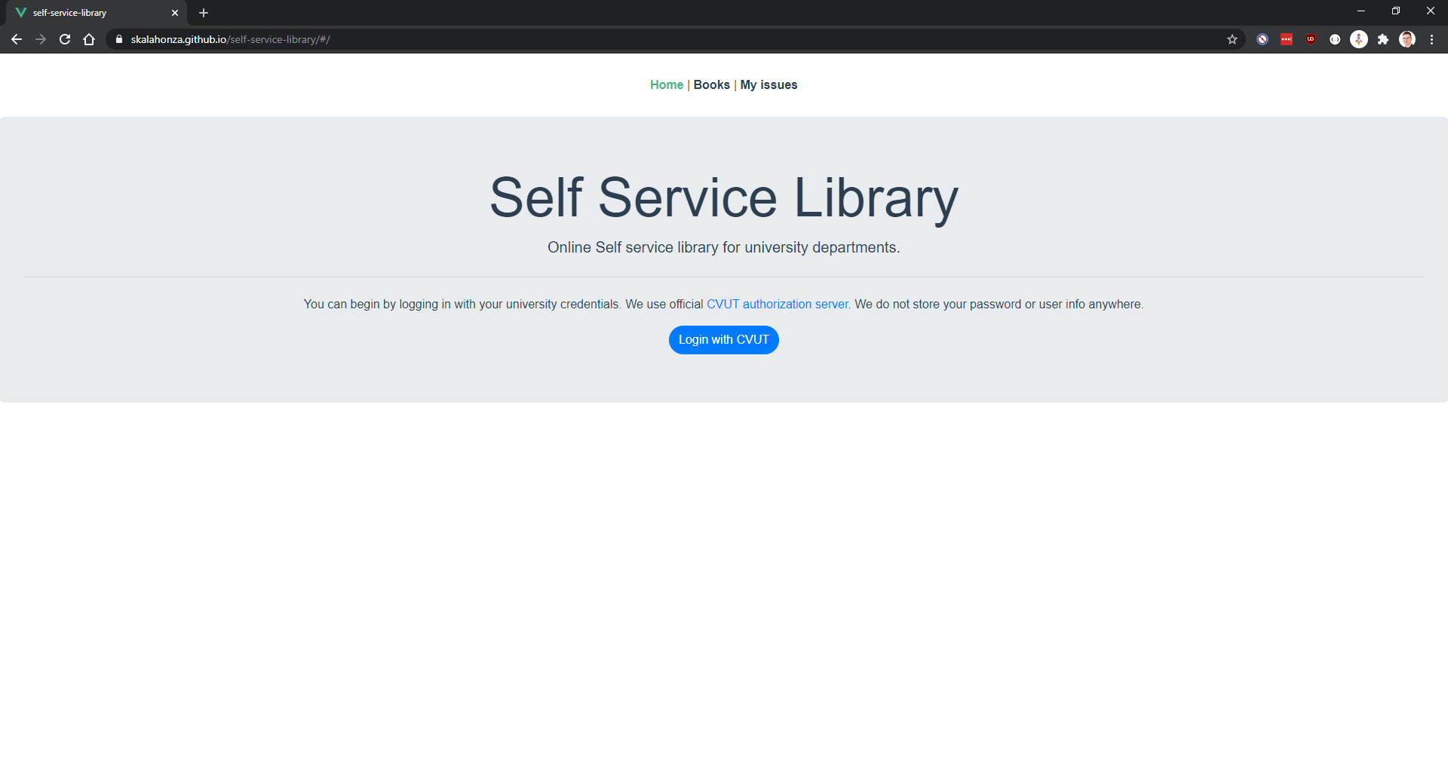
Sign in
Place your screenshot here
Use your CVUT identity.

Slide 7
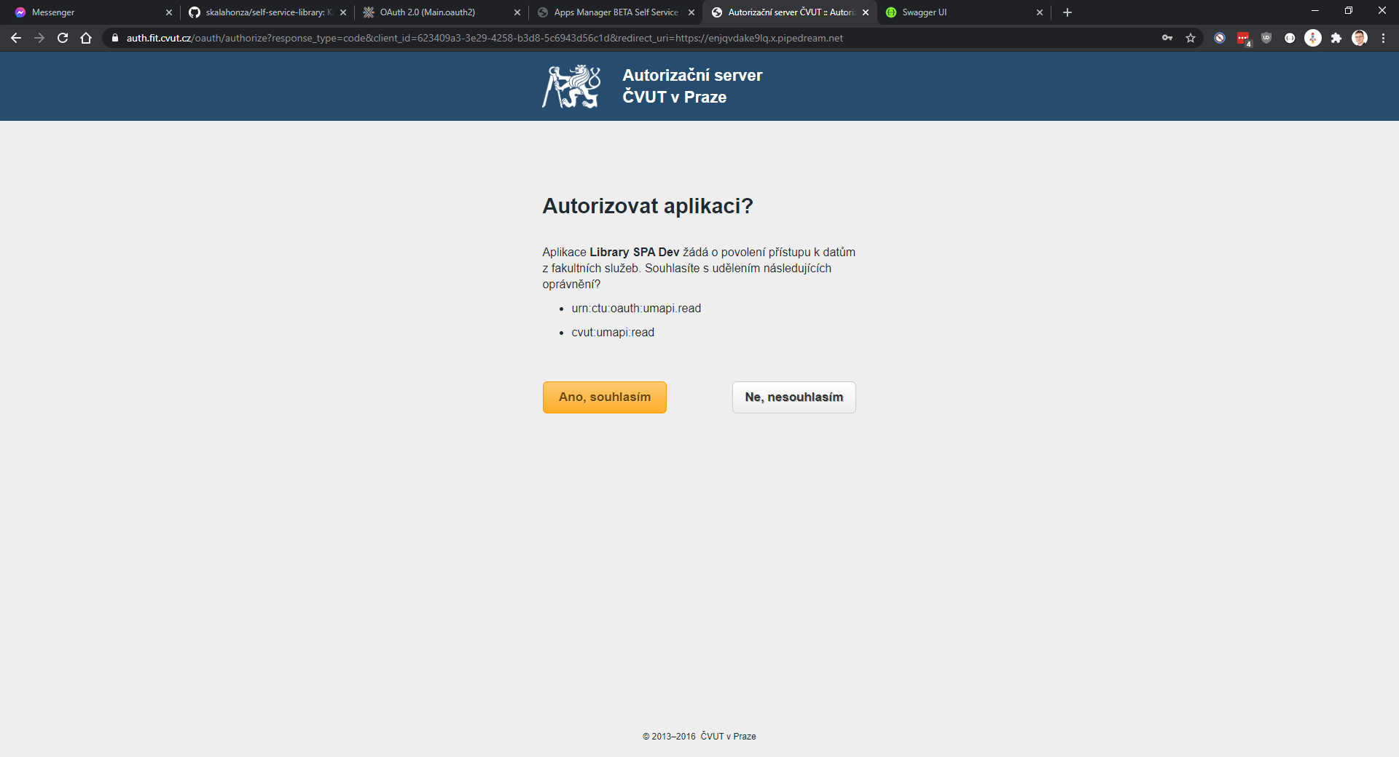
Sign in
Place your screenshot here
Approve that we can read your Usermap info.

Slide 8
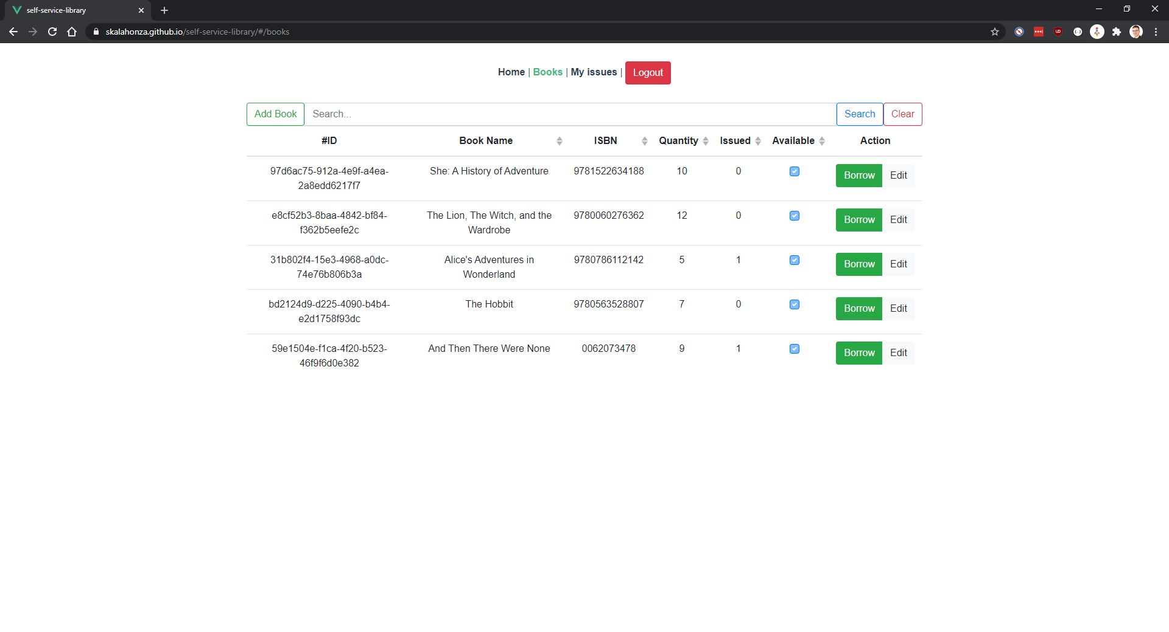
Books
Place your screenshot here
Browse books
Add new
Edit existing

Slide 9
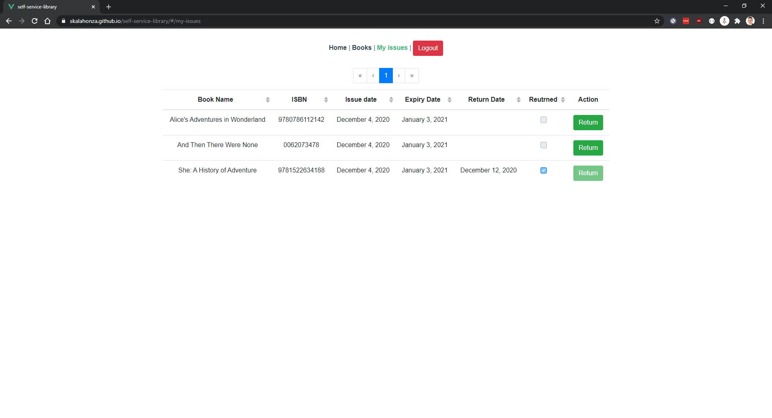
Issues
Place your screenshot here
Browse your issues
Return a book

